Slide 1
Data skills for biology workshop 2024
While we wait, access the slides and exercises at : And add a couple songs to the playlist! ☺
github.com/conkline/DataSkillsWorkshop2024
https://open.spotify.com/playlist/5gZHBE0vh4oOkffmON9PNl?si=98736a424a404b2d&pt=9f1c43849bdfcc267873d90bbffa2386

Slide 2
SPATIAL DATA IN R
Emily Conklin (she/they)
Data Skills for Biology Workshop 2024

Slide 3
INTRO to spatial data

Slide 4
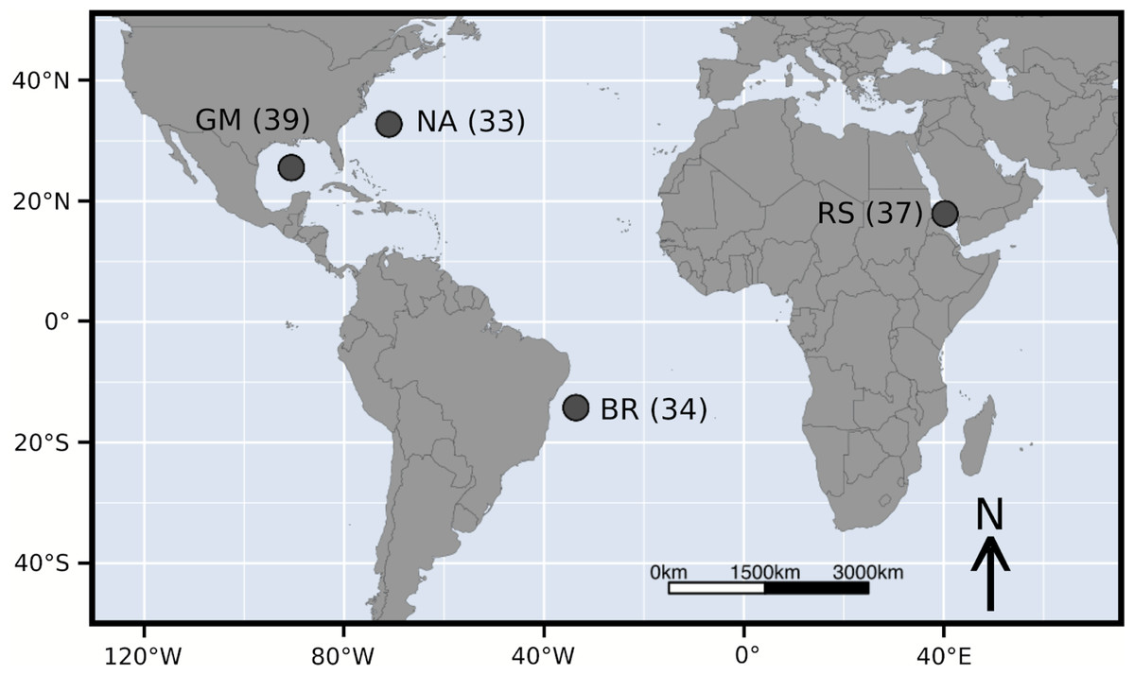
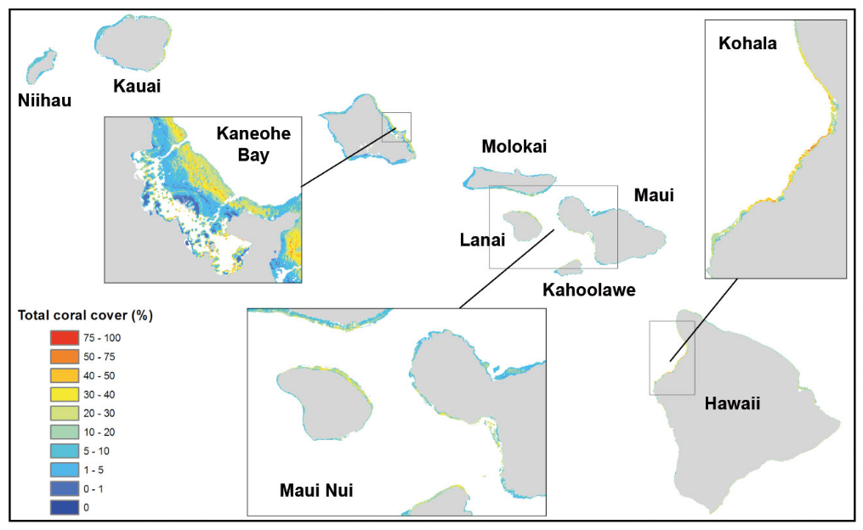
Almost everyone has to deal with spatial data
Kraft et al. 2020
Franklin et al. 2013
An in-demand skill, and R provides lots of useful tools

Slide 5
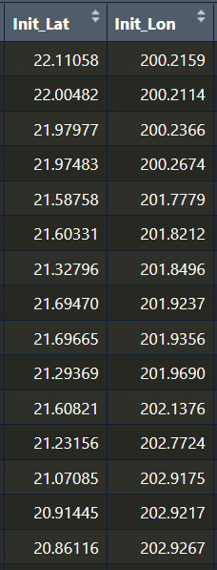
Lat/lon: More than just another variable
Paired data – lose much of their meaning when treated independently
Often not “just” points – associated with another line, spatial area, or grid cell (transects, country boundaries, etc.)
Nonlinear – the distance between 0º N and 1º N is not the same as the distance between 40º N and 41º N
https://r-spatial.org/book/

Slide 6
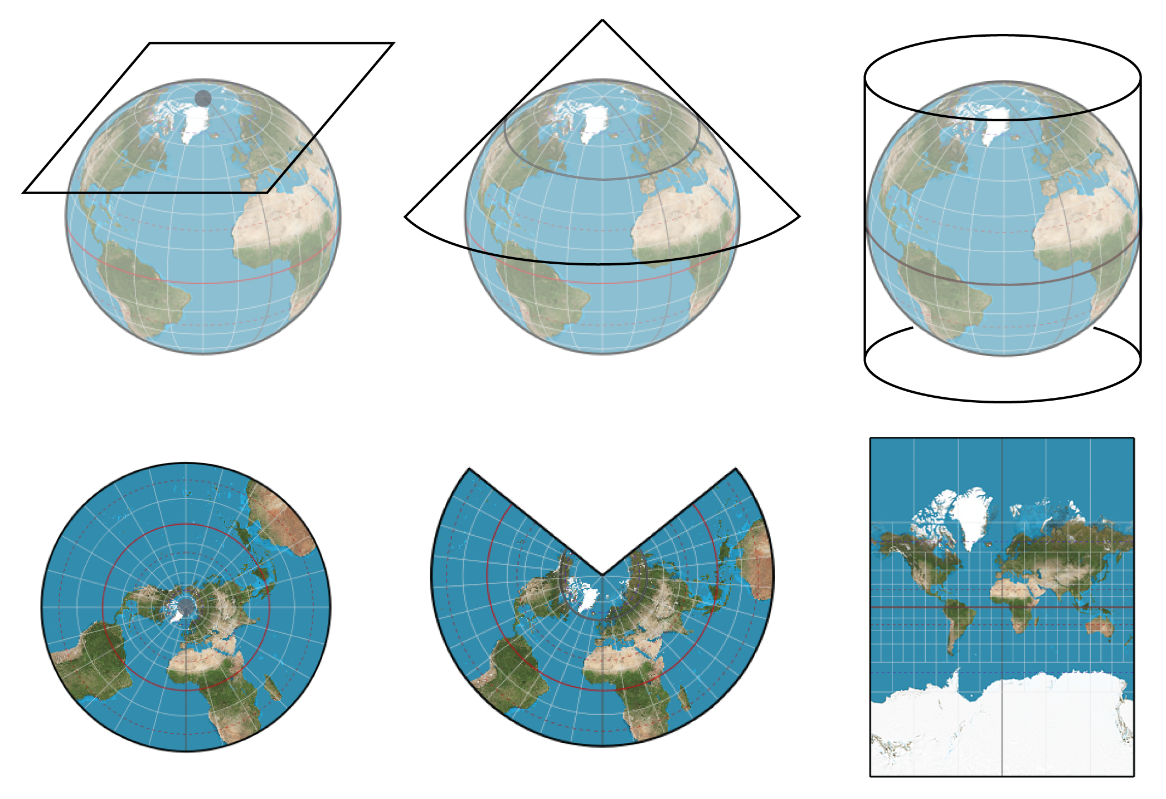
What’s a Map Projection?
2D representation of 3D earth
https://gistbok.ucgis.org/bok-topics/map-projections
Notes:
Flat, conical, cylindrical
Depending on projection, the earth will look different!

Slide 7
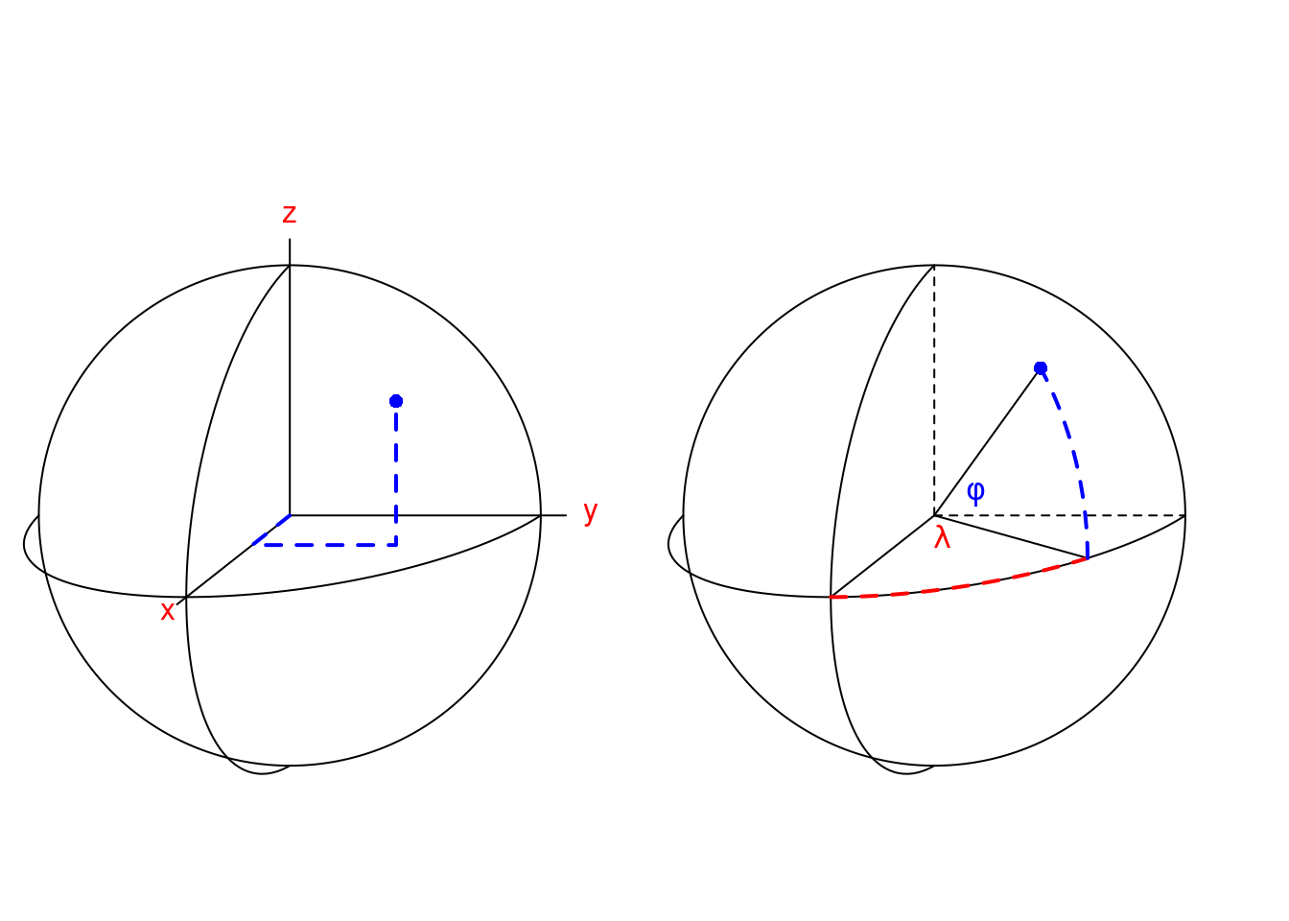
What are coordinates?
Most often, we use spherical coordinates (right)
λ = Longitude, varies from -180º to 180º (or 0º to 360º)
Φ = Latitude, varies from -90º to 90º
Sometimes combined with altitude, elevation, or depth
https://r-spatial.org/book/02-Spaces.html
Notes:
Lambda, phi
Cartesian coordinates

Slide 8
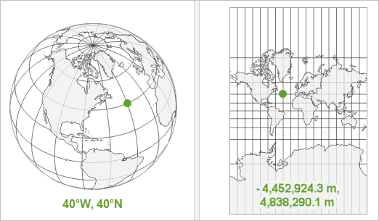
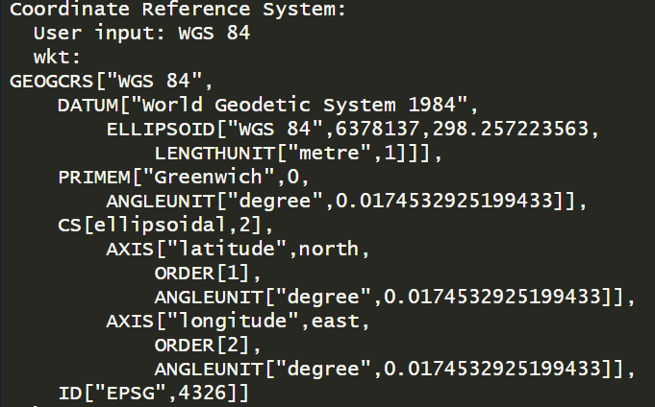
Coordinate reference systems (CRS)
In R:
Geographic coordinate system
(GCS)
Projected coordinate system
(PCS)
CRS tell us how coordinates relate to real locations on earth
https://pro.arcgis.com/en/pro-app/latest/help/mapping/properties/coordinate-systems-and-projections.htm
Notes:
GCS – round, locations given in degrees and directions
PCS – flat, locations given in distances

Slide 9
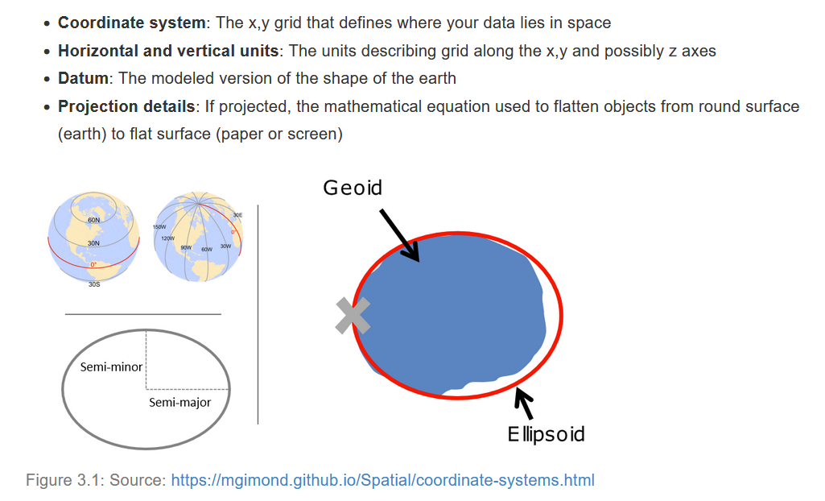
Components of CRS
Origin
Notes:
Datum – shape and origin

Slide 10
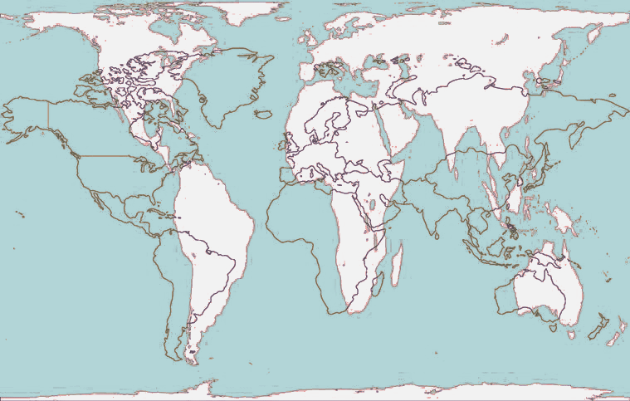
Always be mindful of crs
Important to know if data is projected, and if so, which projection is being used
Most common projection is WGS84 – good for global projections
When using multiple datasets:
Do they have the same CRS?
If not, we need to transform them so they align

Slide 11
TYPES OF SPATIAL DATA in R

Slide 12
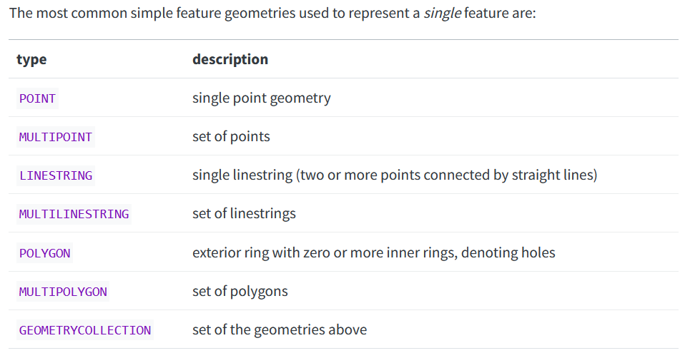
Vector data – YAY, SHAPES!
https://r-spatial.org/book/03-Geometries.html
Notes:
Other fancier geometries, but I’ve never used them!

Slide 13
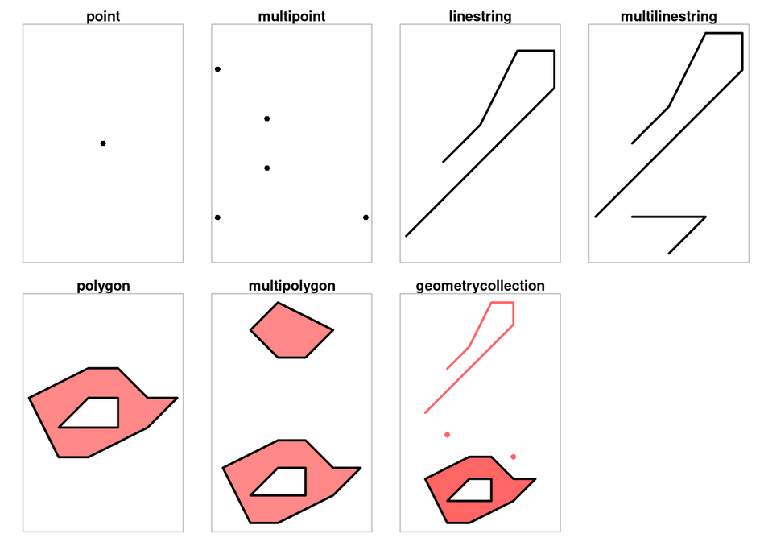
Vector data – YAY, SHAPES!
Collection sites
Observations
Transects
Dispersal/migration paths
Land masses
Habitat area
Boundaries (countries, EEZ, moku, et cetera)
https://r-spatial.org/book/03-Geometries.html

Slide 14
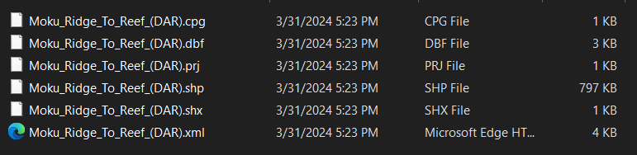
Vector data lives in shapefiles
Shapefiles are a set of files, with data distributed across file types Contain location, shape, and attributes
Required: .shp, .shx, .dbf
Optional: .xml, .prj, .sbn, .sbx
So – when sharing/downloading shapefiles, make sure you get the whole thing!
https://r-spatial.org/book/03-Geometries.html

Slide 15
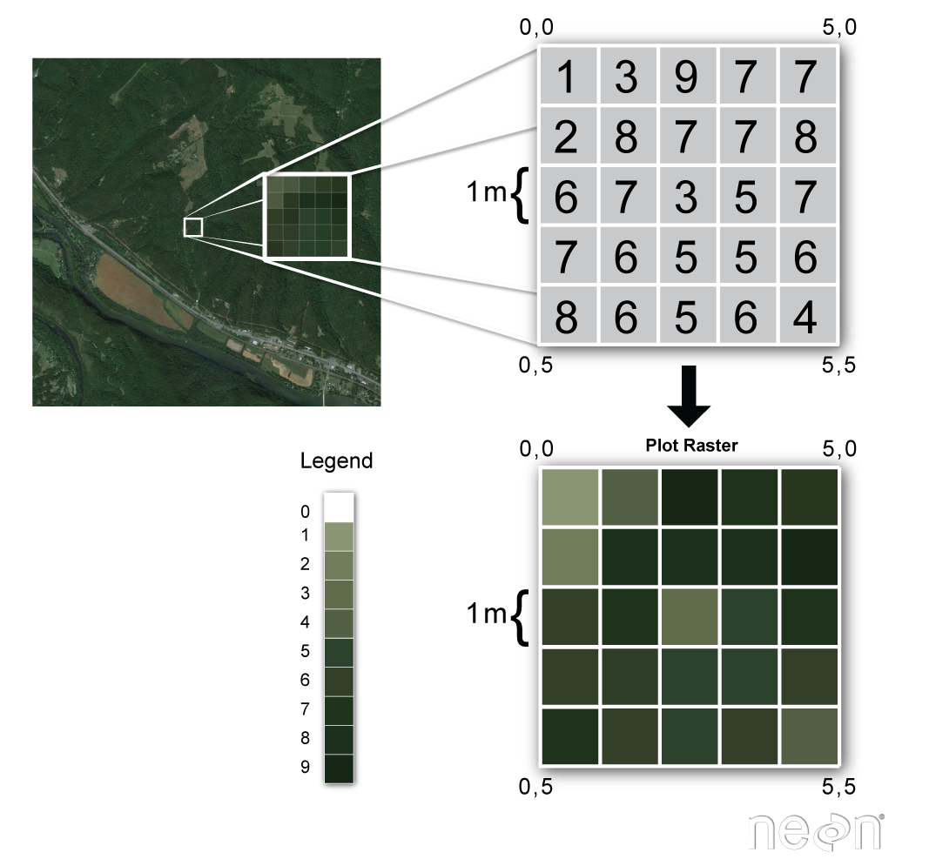
RASTER data – YAY, GRIDS!
Data are stored as a grid of values, represented on a map as pixels
Used to represent spatially continuous data (elevation, temperature, habitat cover, etc.)
https://www.neonscience.org/resources/learning-hub/tutorials/dc-raster-data-r

Slide 16
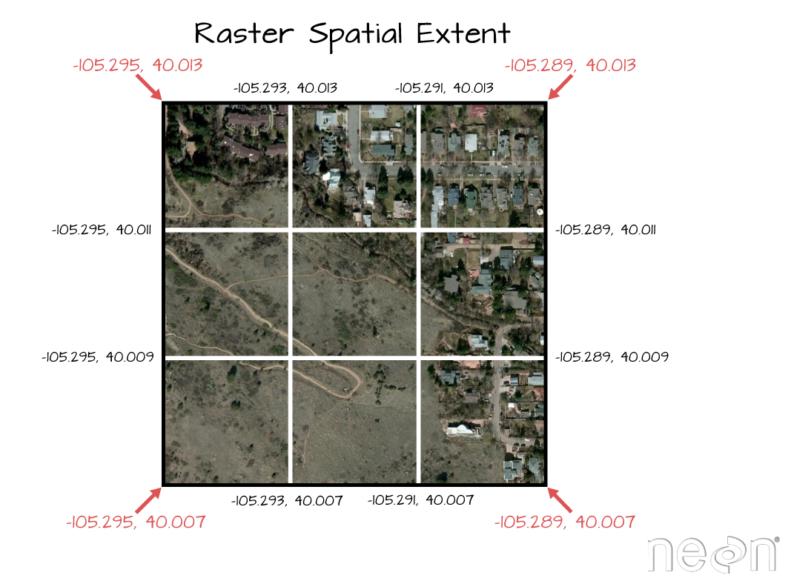
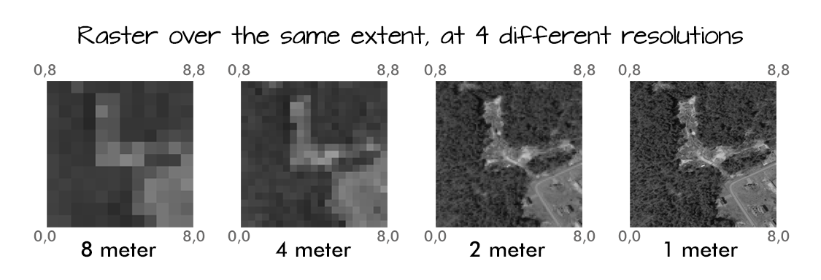
RASTER data – YAY, GRIDS!
In addition to CRS, raster objects have an extent and a resolution Unlike vector data, raster data is not explicitly stored as coordinates
Most commonly saved as .tiff,
but also .png, .nc, .crf, .dat, .geojson, and more
https://www.neonscience.org/resources/learning-hub/tutorials/dc-raster-data-r

Slide 17
Exercise #1
If a file has a .shp extension, does it contain vector data or raster data?
What should you be mindful of when combining multiple spatial datasets?
What are three vector data geometry types?

Slide 18
Exercise #1
If a file has a .shp extension, does it contain vector data or raster data?
Vector data!
What should you be mindful of when combining multiple spatial datasets?
Their CRS!
What are three vector data geometry types?
Point, line, and polygon!

Slide 19
SIMPLE FEATURES (SF): Vector Data

Slide 20
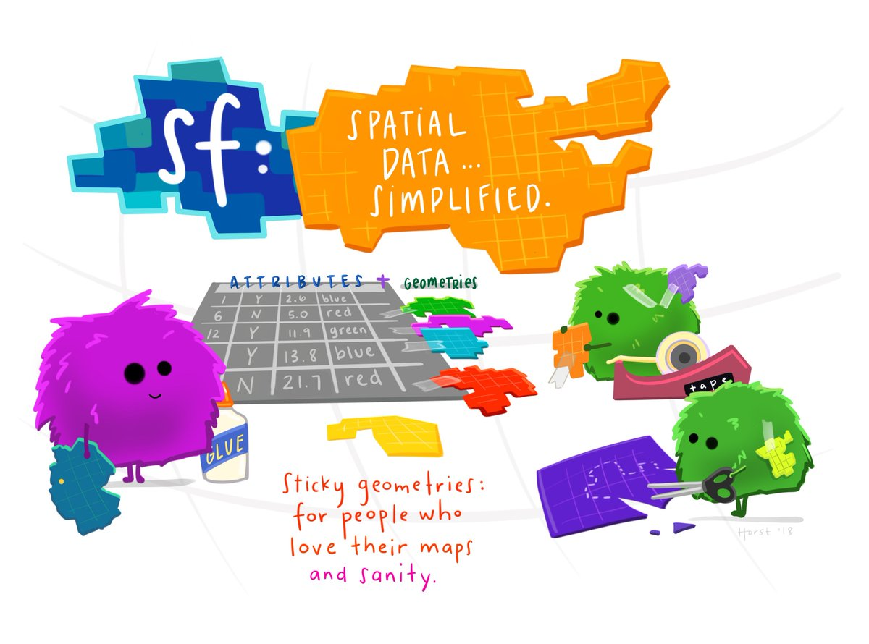
Allison Horst 2018

Slide 21
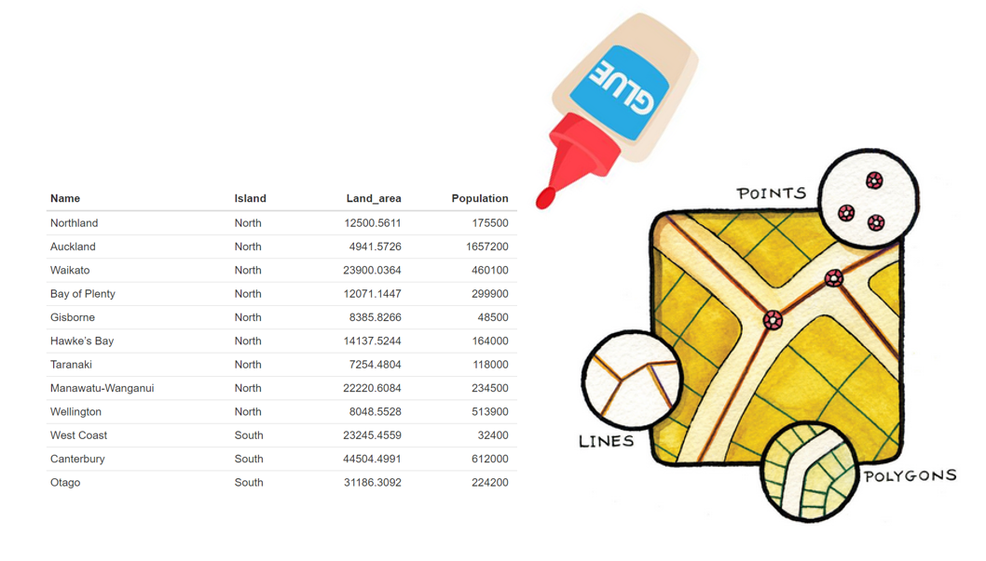
What is “Sticky” Geometry?
Geometry is all contained in a single column, and it will follow the data no matter how you work with it
https://mhweber.github.io/AWRA_2020_R_Spatial/vector-data-with-sf.html

Slide 22
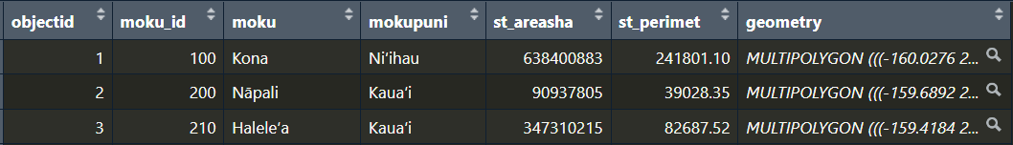
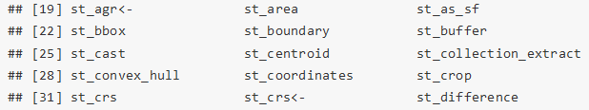
sf package overview
Represents simple features (sf) as records in a data.frame or tibble with a geometry list-column
Can use normal data.frame operations and the pipe operator |> or %>%
All functions and methods in sf start with st_*
Typical use involves creating, reading, manipulating, and writing vector geometry objects

Slide 23
Geometry types – quick reminder
https://r-spatial.org/book/03-Geometries.html

Slide 24

Exercise #2a
Quick sf demo (03exercise_workshop_spatial-data.Rmd)

Slide 25
TERRA: WORKING WITH RASTER DATA

Slide 26

TERRA PACKAGE OVERVIEW
Replaces (can do more, and is faster than) the raster package
Two main classes:
SpatRaster
Multilayer (multivariable) raster data
Stores geometry: number of columns and rows, spatial extent, resolution, and CRS
Stores values: associated with each cell of the raster
SpatVector
Vector data
Stores geometry: points, lines, or polygons, extent, and CRS
Stores attributes: data associated with a vector geometry
Typical use involves creating, reading, manipulating, and writing raster geometry objects
Notes:
Datum – shape and origin

Slide 27
Exercise #3a
Quick terra demo (03exercise_workshop_spatial-data.Rmd)

Slide 28
Other useful R Packages
stars – multilayer raster data
https://r-spatial.github.io/stars/
S2 and geosphere – spherical geometry (distances, bearings, etc.)
https://cran.r-project.org/web/packages/s2/index.html
https://github.com/rspatial/geosphere
gstat – modeling, prediction, simulation
https://cran.r-project.org/web/packages/gstat/index.html
geodata – lots of spatial datasets
https://github.com/rspatial/geodata
sfnetworks – building and plotting spatial networks
https://luukvdmeer.github.io/sfnetworks/
mapview – building interactive web maps
https://r-spatial.github.io/mapview/
tidyterra – tidyverse-ing terra
https://dieghernan.github.io/tidyterra/
rnaturalearth – good base maps
https://cran.r-project.org/web/packages/rnaturalearth/vignettes/rnaturalearth.html x

Slide 29
Further reading & Exercises
https://github.com/rstudio/cheatsheets/blob/main/sf.pdf
https://r-spatial.org/book
https://r-spatial.github.io/sf/
https://www.r4wrds.com/intro/m_intro_mapmaking
https://rspatial.org/spatial
https://www.paulamoraga.com/tutorial-terra/
https://www.neonscience.org/resources/learning-hub/tutorials/dc-raster-data-r
https://oceanhealthindex.org/news/raster_to_terra/

Slide 30
Free work time!
Ask questions
Work on exercises #2b & #3b
Work on your own spatial data project
Check out some of the packages or exercises linked in the slides
Find a fun dataset using the package geodata
Take off if you need to!
Add a song to the playlist:
https://open.spotify.com/playlist/5gZHBE0vh4oOkffmON9PNl?si=98736a424a404b2d&pt=9f1c43849bdfcc267873d90bbffa2386

